Slide 1

Teacher of Science

Slide 2
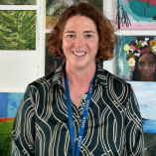

Inspired by Excellence & Innovation “I have come so that they may have Life and have it to the Full” – John 10:10
Headteacher’s Welcome
I would like to welcome and introduce you to Ellesmere Port Catholic High School.
Our mission says, ‘I have come so that they may have life and have it to the full’ (John 10:10) and we believe that every student here can achieve great things wherever their skills and talents lie.
Students tell us that the time they spend here is very special. Within our caring community, new skills are learnt, knowledge increased, new friends made, and futures planned. When students look back before they leave us to go to university, college, an apprenticeship or employment, they are frequently amazed at what they have achieved and how they have developed as a confident young adult.
As a prospective employee, we encourage you to visit our school, look around and please contact us if you would like to know more.
Mrs Henderson
Acting Headteacher
2

Slide 3
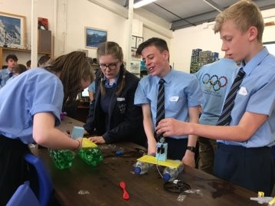

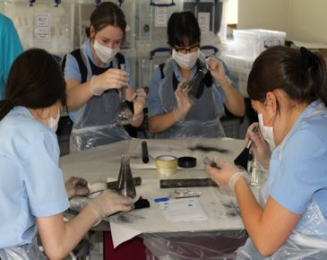
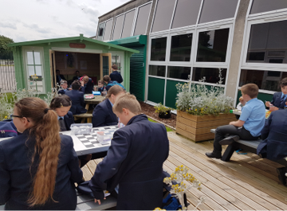
Ellesmere Port Catholic High School is a school with a unique sense of community, where every student is known, where there is exemplary student behaviour, a culture built on striving for excellence and where there are exceptionally high aspirations for everyone.
The highest quality of Teaching
The highest quality of Leadership
The highest quality of Pastoral Support and Guidance
The highest quality of Extra-Curricular, Enrichment and Volunteering Programmes
With 948 students on roll at Ellesmere Port Catholic High School, we are a successful, oversubscribed school situated in Ellesmere Port. We are approximately 7 miles from Chester and approximately 14 miles from Liverpool making commute times short.

Slide 4
Values & Mission Statement
Ellesmere Port Catholic High School aims to provide a Roman Catholic education in an environment within which all members of the community are encouraged to develop their spiritual, moral, academic, creative and physical potential, based on the teachings of Jesus.
Our Vision
Our school’s vision is:
To promote the dignity and worth of each person
To have a strong catholic Ethos
To ensure every child is known
To have high expectations of everyone
To have excellent leadership at all levels
To provide excellent teaching
To encourage exemplary behaviour and personal standards
To be at the heart of the community
Promotion of British values
Our priorities
To enhance the Catholic Life of the school, including Catholic Social Teaching (CST), Celebration of the Word, and student participation, in line with the Diocesan Inspection Framework and the Prayer & Liturgy Directory (PARTICIPATION)
To improve outcomes through high-quality teaching, strong leadership, and effective intervention, ensuring progress for all learners, particularly SEND and disadvantaged students (PARTICIPATION & PROGRESS)
Embed a consistent, positive behaviour culture across the school by clarifying expectations, equipping staff through targeted CPD and coaching, and reinforcing routines and recognition systems to reduce incidents and improve student engagement (PARTICIPATION)
To strengthen leadership at all levels so that safeguarding, behaviour, attendance and curriculum systems are delivered with precision, consistency and accountability, ensuring a culture of high standards across the school (PRESENCE & PARTICIPATION)
To build a whole-school equity-driven inclusion system where every pupil is known, supported and challenged, and where all staff take shared responsibility for removing barriers to learning and ensuring strong progression for all (PRESENCE & PARTICIPATION)
4

Slide 5

5

Slide 6
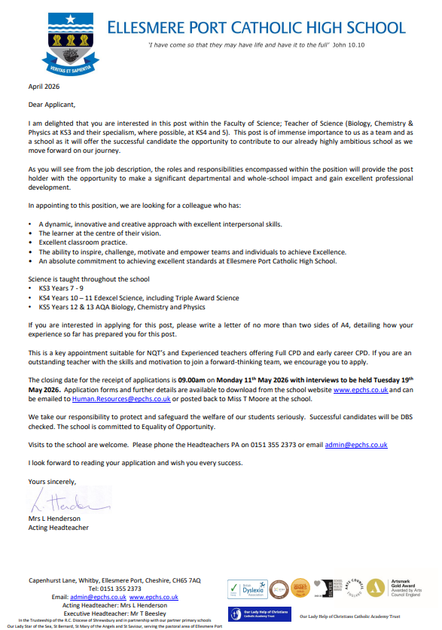

Slide 7
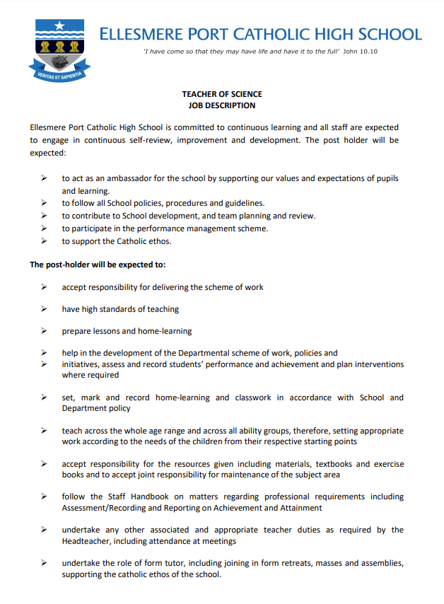

Slide 8


Slide 9
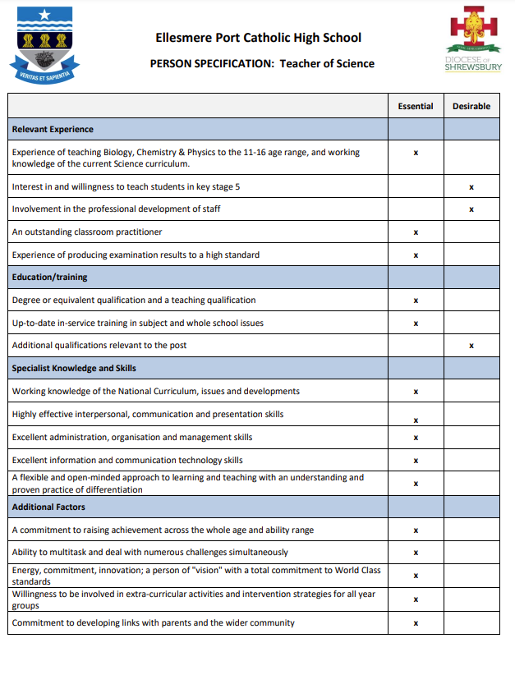

Slide 10
Guidance for Applicants
How to apply
The Job Description and the Person Specification for this role are essential to the recruitment process. Please ensure you refer to both documents when completing your application.
If you feel you have the right qualities to join our forward thinking school, please complete the application form which is available to download from our vacancies section on our school website. We are committed to treating our applicants fairly and with respect, only application forms that are fully completed will be accepted. If you wish to include a supporting letter, please ensure it is no longer that 2 sides of A4.
Shortlisting
The shortlist process will consist of an interview panel who will be objective, and follow a thorough and rigorous analysis of all applications. The decision on interview selection will be based on how well applicants meet the job description and person specification. Any discrepancies or anomalies in the information provided will be taken up at interview.
Candidates will be contacted and invited to Interview and will be informed that references will be requested before the interview. Referees must know that they are going to be contacted before application. The requirements are that you must provide a contact name of a person, not a company in general, their position, a postal address, telephone number and email address.
New Safer recruitment guidelines state that we must now also complete an online search for all shortlisted candidates.
The Interview
During the interview process we will take every opportunity to find out if you are the right person for the role. It will offer you a range of opportunities to demonstrate your potential to meet the requirements of the post and for you to find out more about the school and those who work here. Depending on the role you are applying for there may be different procedures used:
A Lesson Observation
A Presentation
A Data task
A formal interview
A Student panel
A Tour of the school
Once interviews are complete, you will be told when you are likely to be informed of the decision. Unsuccessful applicants are able to request feedback.
Following acceptance, applicants will be required to complete and enhanced DBS check and a medical questionnaire, these must be completed as soon as possible.
Safeguarding statement
Ellesmere Port Catholic High School is committed to Safeguarding and promoting the welfare and safety of our students. We expect all staff and volunteers to share this vision. Therefore, applicants will complete a Criminal Record Check (Disclosure) from the Disclosure and Barring Service. You will also be required to complete a Rehabilitation of Offenders Act 1974 Form, this will show any spent conviction. Applicants must disclose whether they have any previous convictions whether or not they are spent. This will be discussed with the Headteacher/Business Manager giving the opportunity to establish suitability for the role. Any information you provide will be kept in confidence and will only be used in respect of your application for the position.
10

Slide 11

Contact Details:
Ellesmere Port Catholic High School
Phone
0151 355 2373
HR Email
Human.Resources@epchs.co.uk
Admin Email
Admin@epchs.co.uk
www.epchs.co.uk
Address
Website
Capenhurst Lane
Whitby
Ellesmere Port
Cheshire
CH65 7AQ
1
2
3
4
5
11

Slide 12


